Slide 1
An efficient and privacy preserving biometric identification scheme in cloud computing with blockchain
RNS INSTITUTE OF TECHNOLOGY
BENGALURU - 98
DEPARTMENT OF INFORMATION SCIENCE & ENGINEERING
Project Presentation
Anant Dubey : 1RN18IS017
Dinky Asrani : 1RN18IS039
Leena Chandra : 1RN18IS063
Raashil Aadhyanth: 1RN18IS081
Internal Guide
Mrs. Sudha V
Asst. Prof, Dept of ISE, RNSIT
Project Coordinator
Dr. Prakash S
Ms. Kusuma S

Slide 2
AGENDA
Introduction
System Requirements
Literature Review
Problem Identification
Objectives
Methodology
System design
Testing
Results and Discussions
Paper published details
Conclusion
References

Slide 3
INTRODUCTION
Biometric identification has raised increasingly attention since it provides a promising way to identify users. Compared with traditional authentication methods based on passwords and identification cards.
The database owner who is responsible to manage the national fingerprints database, may desire to outsource the enormous biometric data to the cloud server (e.g., AWS) to get rid of the expensive storage and computation costs.
However, to preserve the privacy of biometric data, the biometric data has to be encrypted before outsourcing.
Whenever a partner wants to authenticate an individual’s identity, he turns to the owner and generates an identification query by using the individual’s biometric traits.
The owner encrypts the query and submits it to the cloud to find the close match.

Slide 4
SYSTEM REQUIREMENTS
FUNCTIONAL REQUIREMENT
User has to login by using username and password
a quality check module to determine whether the acquired biometric sample is of sufficient quality for further processing,
an enhancement module to improve the biometric signal quality
NON-FUNCTIONAL REQUIREMENT
Usability
Simple is the key here. The system must be simple that people like to use it, but not so complex that people avoid using it. .
Reliability
The system should be trustworthy and reliable in providing the functionalities
Performance
The system should not succumb when many users would be using it simultaneously.
Scalability
The system should be scalable enough to add new functionalities at a later stage.

Slide 5
SYSTEM REQUIREMENTS
HARDWARE REQUIREMENTS:
· System : intel i5 and above
· Hard Disk : 500 GB.
· Ram : 4 GB
SOFTWARE REQUIREMENTS:
Operating system : Windows 8 / 7
Coding Language : Java (Jdk 1.7)
Web Technology : Servlet, JSP
Web Server : TomCAT 6.0
IDE : Eclipse
Database : My-SQL 5.0
UGI for DB : SQLyog
JDBC Connection : Type 4 Driver

Slide 6
LITERATURE REVIEW
Sl. No | Name of the Paper | Proposed Technique | Limitations | Future Enhancement | Dataset Used
1 | Efficient and privacy-preserving biometric identification using face authentication | 3d morphable model using linear shape and texture error functions. | High Complexity, Time complexity | Reduce Complexity | Real World Data
2 | Privacy preserving biometric identification scheme | Matrix and perturbed terms | Long Training Time | Attempt to reduce training time | UCSD
3 | Biometric-oriented Iris identification | Mathematical morphology | Difficult to implemet | - | University of Bath iris image Dataset
4 | Face recognition with enhanced privacy protection | Sorted index numbers | Model Complexity | Can be exercised on larger dataset | LAD

Slide 7
LITERATURE REVIEW
Sl. No | Name of the Paper | Proposed Technique | Limitations | Future Enhancement | Dataset Used
5 | Privacy-preserving fingerprint identification systems | asymmetric homomorphic encryption algorithm | computation cost is high | - | Avenue, UCSD
6 | Efficient and privacy-preserving biometric identification in cloud | symmetric homomorphic encryption algorithm in biometric identification | Require Human Feedback | Less human feedback | Maryland
7 | Efficiency-improved fingerprint identification scheme | matrix operations | trade-off between efficiency and privacy | server has the authority to access the fingerprint database | Synthetic Data, Real-world Data

Slide 8
PROBLEM IDENTIFICATION
Most of Existing systems mainly concentrate on privacy preservation but ignore the efficiency.
Suffering from performance problems of local devices, these schemes are not efficient.These existing systems were proven insecure.
Specifically, our main contributions can be summarized as follows:
We examine the biometric identification scheme and show its insufficiencies and security weakness under the proposed level-3 attack.
The detailed analysis shows that the proposed scheme can achieve a required level of privacy protection.
the performance analysis shows that the proposed scheme provides a lower computational cost in both preparation and identification procedures.
Specifically, our scheme is secure under the biometric identification outsourcing model and can also resist the attack proposed.

Slide 9
OBJECTIVES
The main objective of this system is to give more security with help of an efficient and privacy preserving biometric identification outsourcing scheme.
With the development of cloud computing, database owners are motivated to outsource the large size of biometric data to the cloud to get rid of the expensive storage and computation costs, however it brings potential threats to users' privacy.
In order to strengthen the validation process of the document and the transactions carried out, blockchain technology is applied maintaining some current security measures used in a current identification document as for example holograms, barcodes, 3D images.
The blockchain technology will be used to record and verify the transactions made by all citizens registered in the electoral census

Slide 10
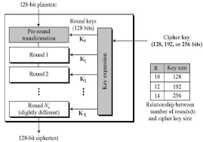
METHODOLOGY
AES ALGORITHM
AES stands for Advanced Encryption Standard and is a majorly used symmetric encryption algorithm. It is mainly used for encryption and protection of electronic data. It was used as the replacement of DES(Data encryption standard) as it is much faster and better than DES. AES consists of three block ciphers and these ciphers are used to provide encryption of data.

Slide 11
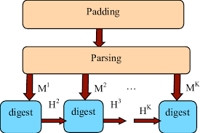
METHODOLOGY
b) SHA1 ALGORITHM
SHA-1 or Secure Hash Algorithm 1 is a cryptographic hash function which takes an input and produces a 160-bit (20-byte) hash value. This hash value is known as a message digest. This message digest is usually then rendered as a hexadecimal number which is 40 digits long. It is a U.S. Federal Information Processing Standard and was designed by the United States National Security Agency.

Slide 12
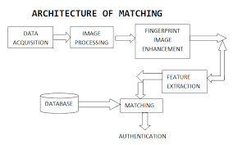
METHODOLOGY
c) FINGERPRINT ALGORITHM
In computer science, a fingerprinting algorithm is a procedure that maps an arbitrarily large data item (such as a computer file) to a much shorter bit string, its fingerprint, that uniquely identifies the original data for all practical purposes just as human fingerprints uniquely identify people for practical purposes. This fingerprint may be used for data deduplication purposes. This is also referred to as file fingerprinting, data fingerprinting, or structured data fingerprinting.

Slide 13

METHODOLOGY
d) CLOUD STORAGE
cloud storage is a cloud computing model that stores data on the Internet through a cloud computing provider who manages and operates data storage as a service. It’s delivered on demand with just-in-time capacity and costs, and eliminates buying and managing your own data storage infrastructure. This gives you agility, global scale and durability, with “anytime, anywhere” data access.

Slide 14
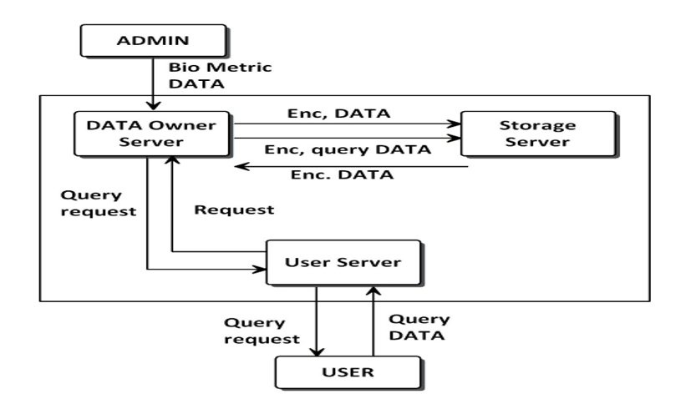
SYSTEM DESIGN

Slide 15
SYSTEM DESIGN
As shown in Figure, three types of entities are involved in the system including the database owner, users and the cloud.
The database owner holds a large size of biometric data (i.e., fingerprints, irises, voice, and facial patterns etc.), which is encrypted and transmitted to the cloud for storage. When a user wants to identify himself/herself, a query request is be sent to the database owner.
After receiving the request, the database owner generates a ciphertext for the biometric trait and then transmits the ciphertext to the cloud for identification.
The cloud server figures out the best match for the encrypted query and returns the related index to the database owner.
Finally, the database owner computes the similarity between the query data and the biometric data associated with the index, and returns the query result to the user.

Slide 16
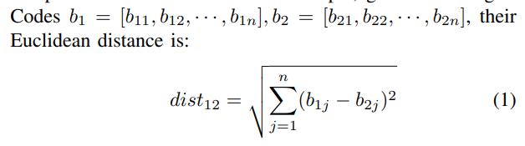
SYSTEM DESIGN
In our scheme, we assume that the biometric data has been processed such that its representation can be used to execute biometric match.
Without loss of generality, similar to and, we target fingerprints and use Finger Codes to represent the fingerprints.
More specifically, a FingerCode consists of n elements and each element is a l-bit integer (typically n = 640 and l = 8). Given two FingerCodes b1 = [b11, b12, · · · , b1n] and b2 = [b21, b22, · · · , b2n], if their Euclidean distance is below a threshold , they are usually considered as a good match, which means the two fingerprints are considered from the same person.

Slide 17
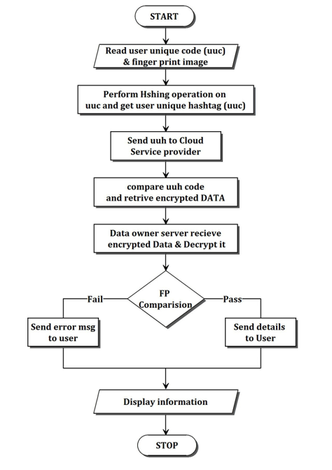
Flowchart

Slide 18
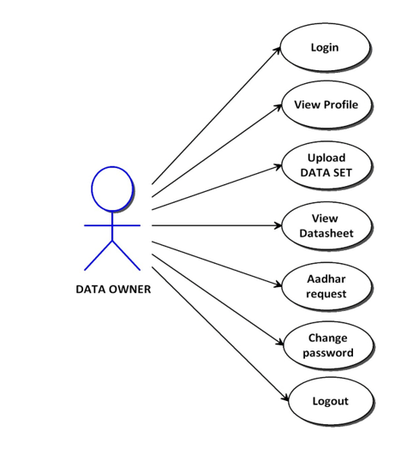
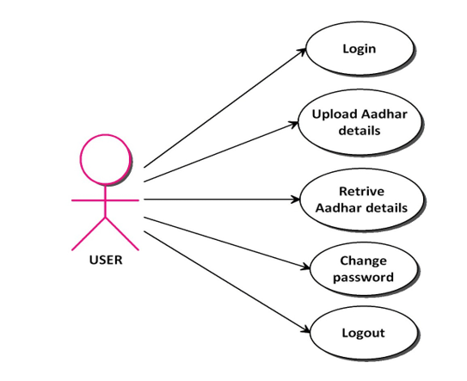
Use Case Diagram
Use case diagram for data owner
Use case diagram for user

Slide 19
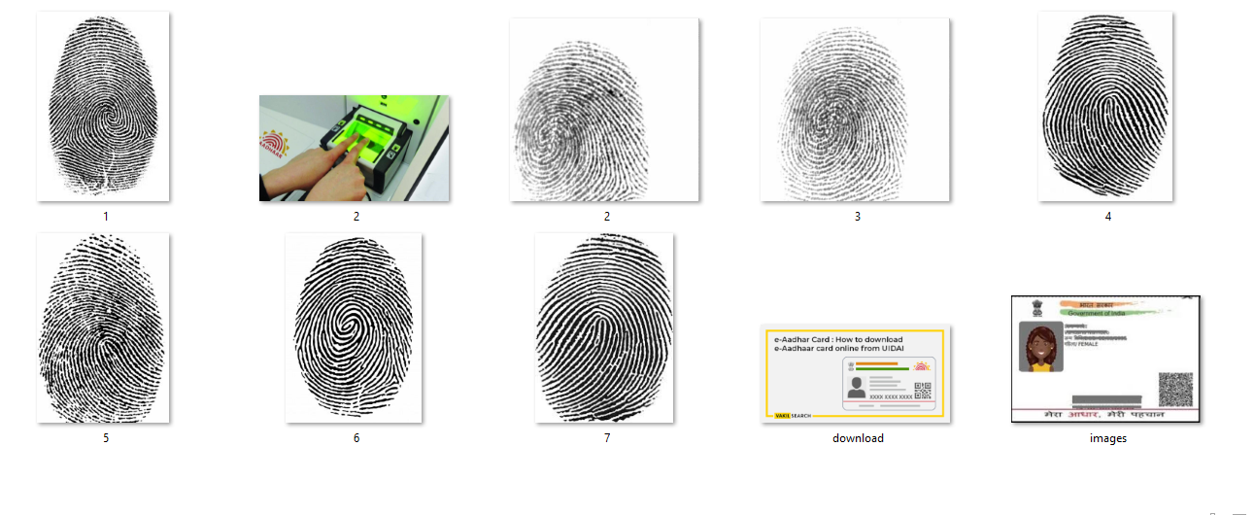
DATA COLLECTION
Sample of personal dats collected. Data also collected from external sources.

Slide 20
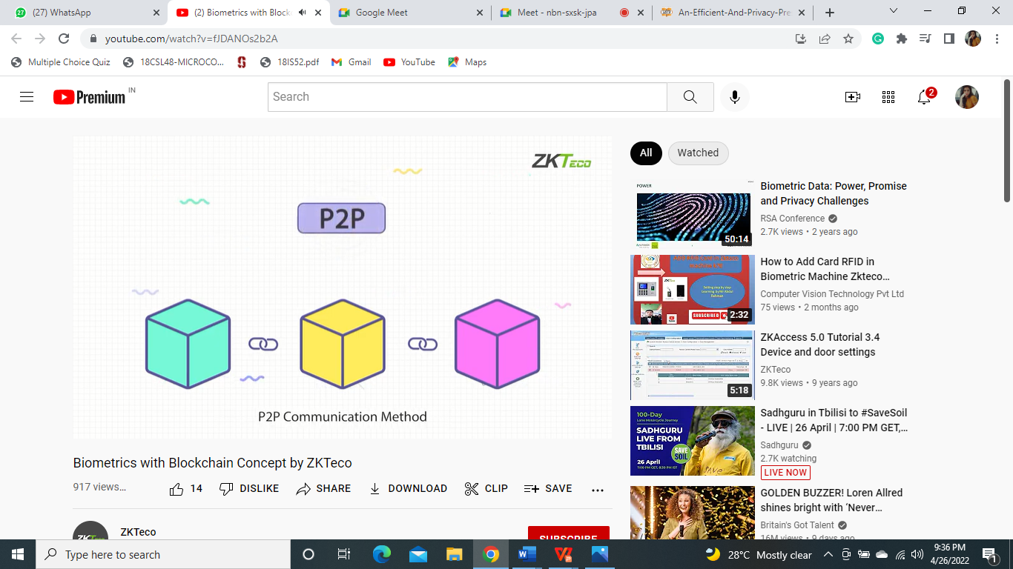
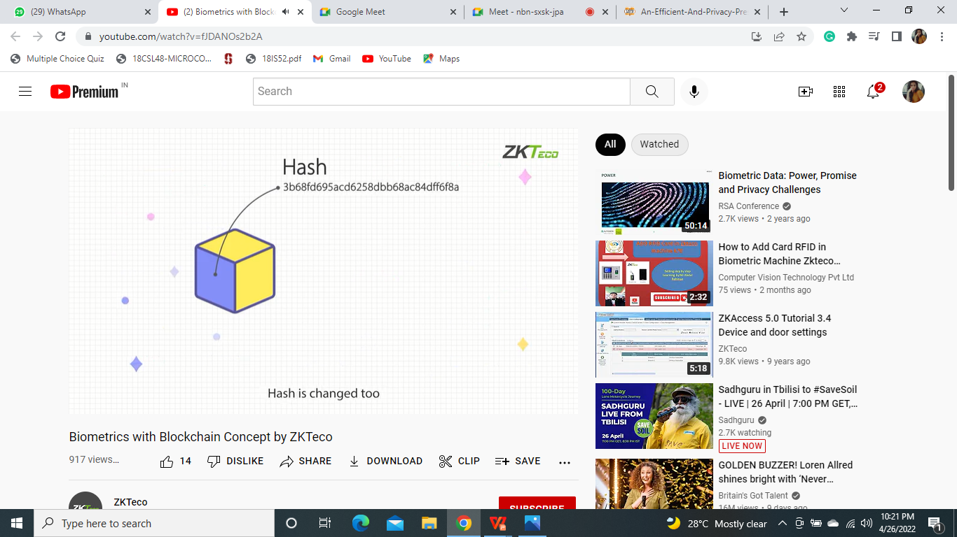
BLOCK CHAIN
Block chain has special encryption methods. In P2P communiation a blockchain is formed in sequential order. Changing anyone of the blocks required permission of other blocks.
The blocks communicate by P2P method which is a completely decentralised in managment, even if the central cyctem is changed it does not affect the reliabilty of the entire system
Each block owns a code relevant to it’s data, known as Has. The hash is relevant to the data stored in the block. Once data is editted the hash is changed too, and becomes a new block and is sequenced to the other blocks again

Slide 21
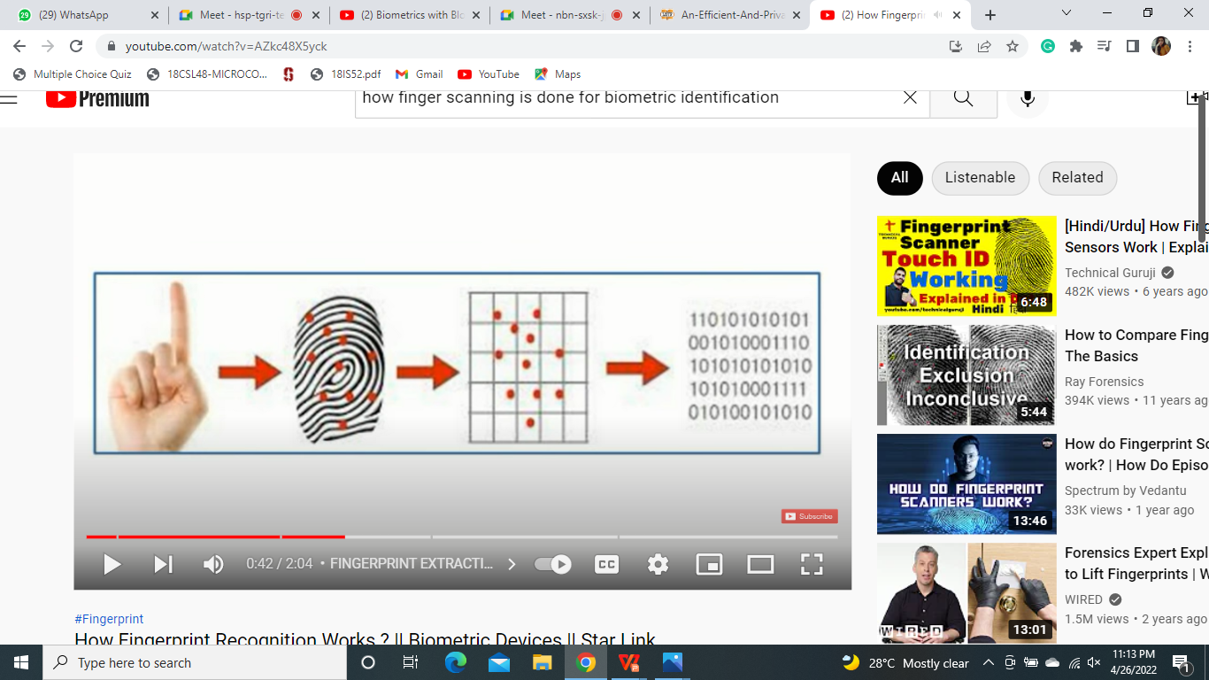
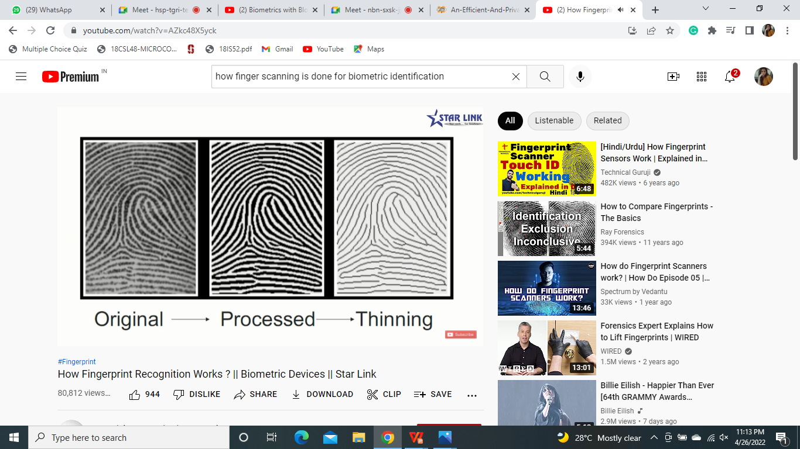
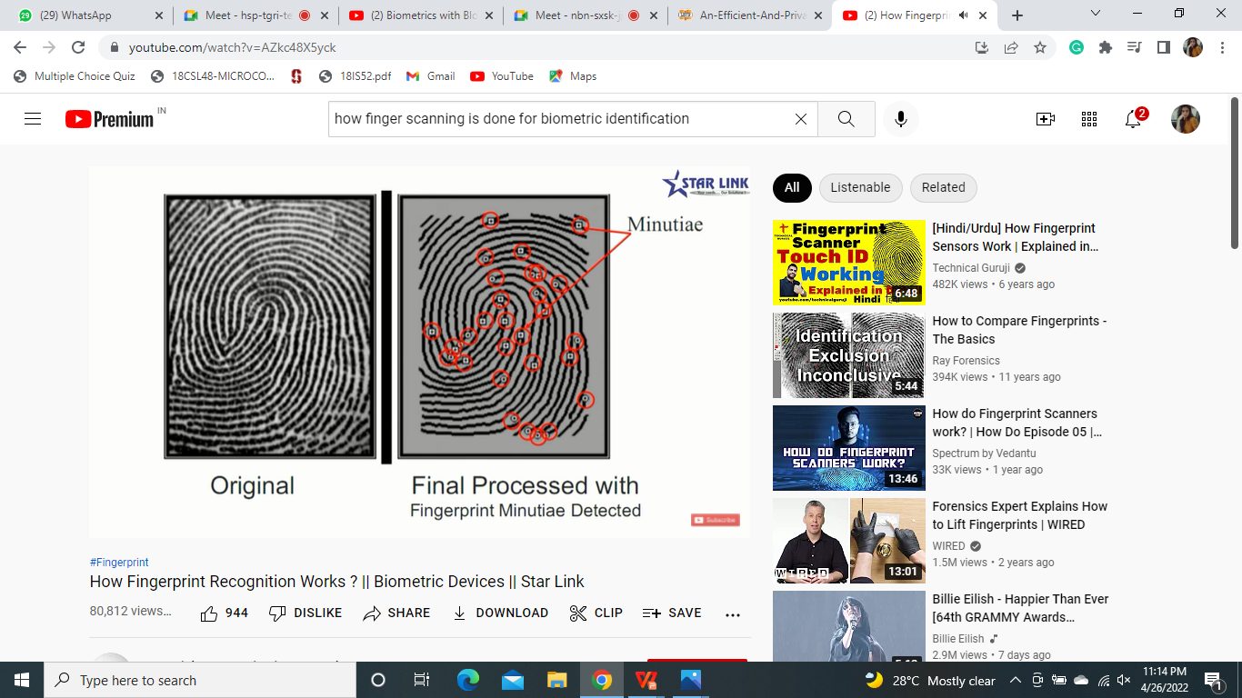
FINGERPRINT SCANNING

Slide 22
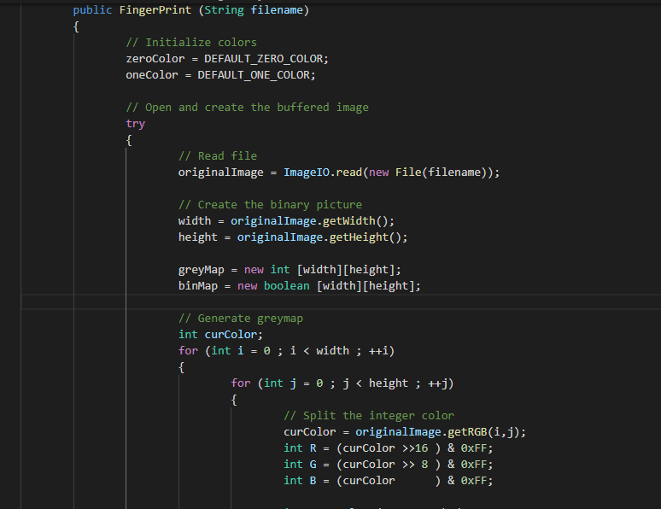
FINGERPRINT SCANNING

Slide 23
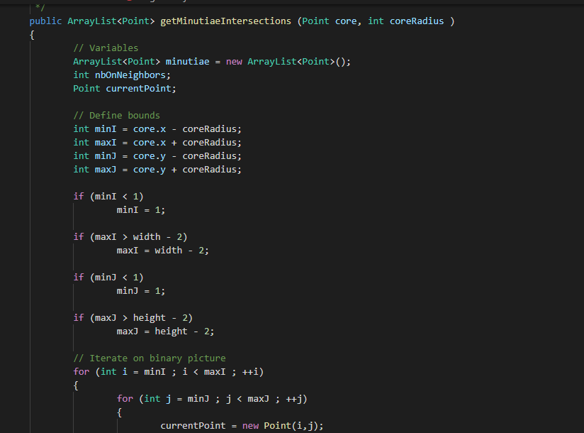
FINGERPRINT SCANNING

Slide 24
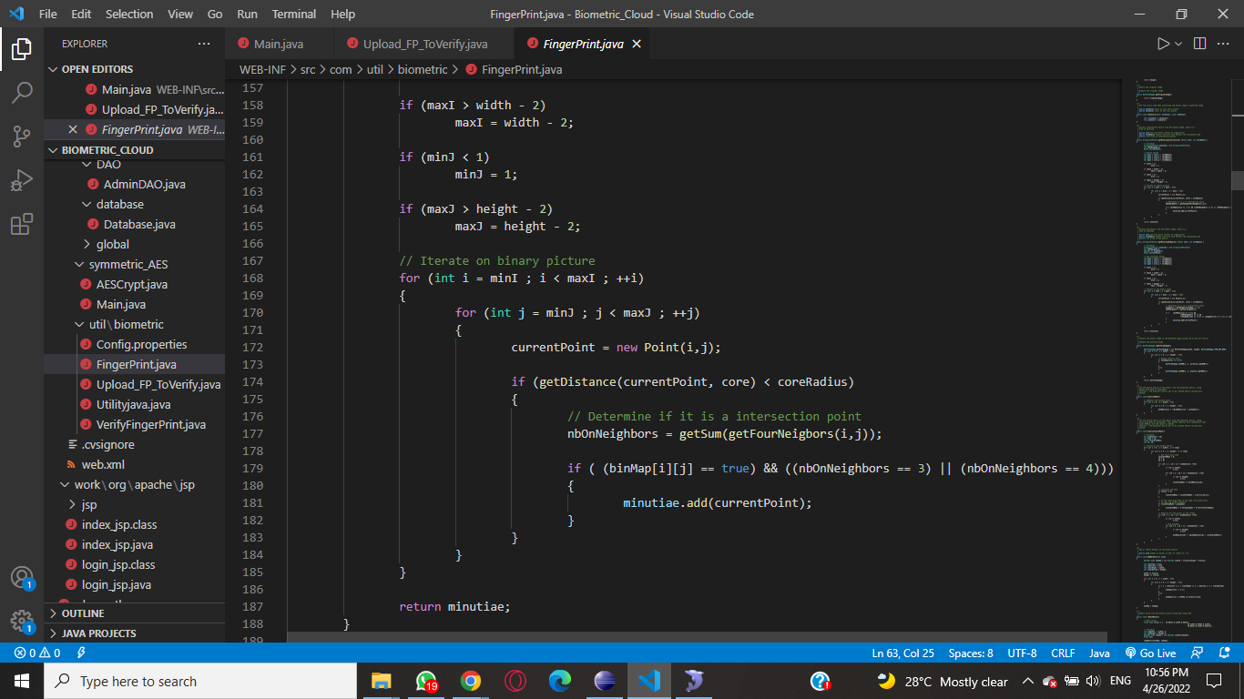
FINGERPRINT SCANNING

Slide 25
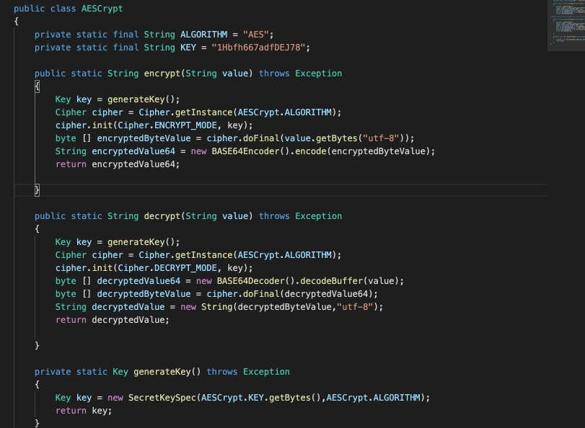
AES ENCRYPTION METHOD

Slide 26
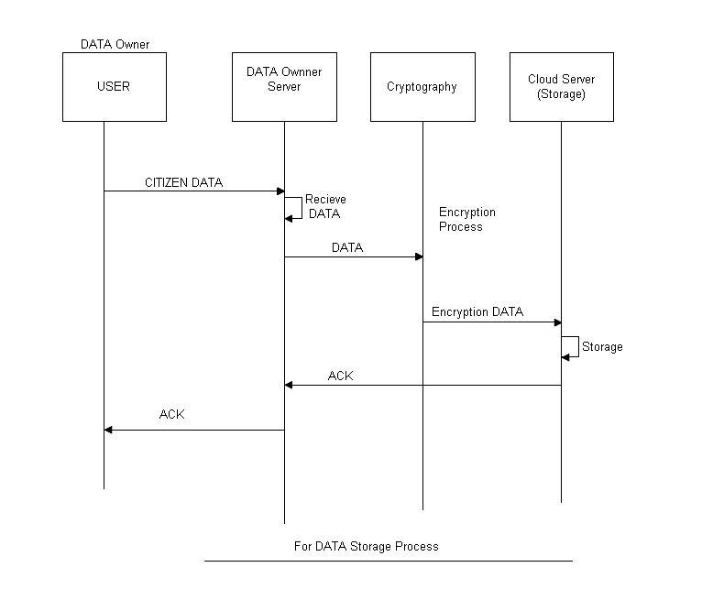
IMPLEMENTATION
Sequence diagram for data storage process

Slide 27
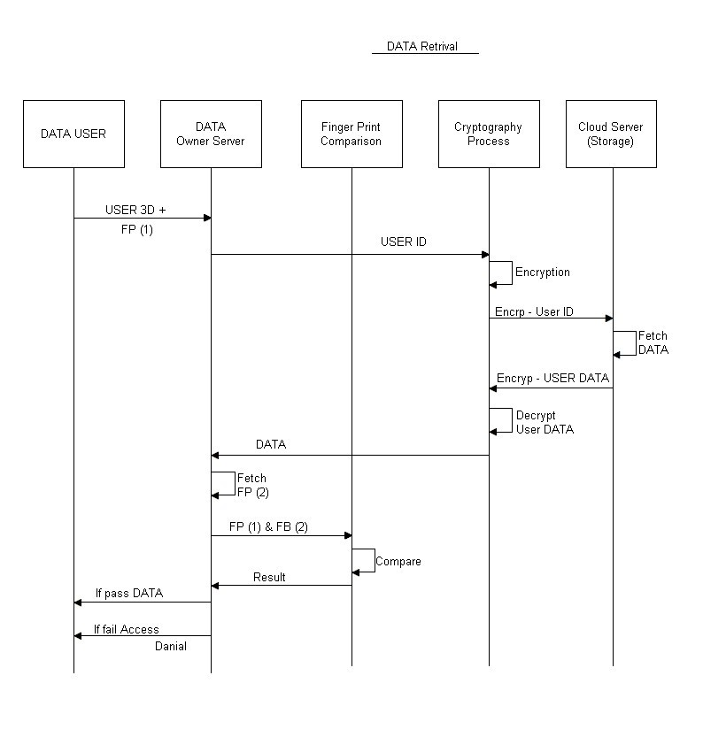
Sequence diagram for data retrieval process

Slide 28
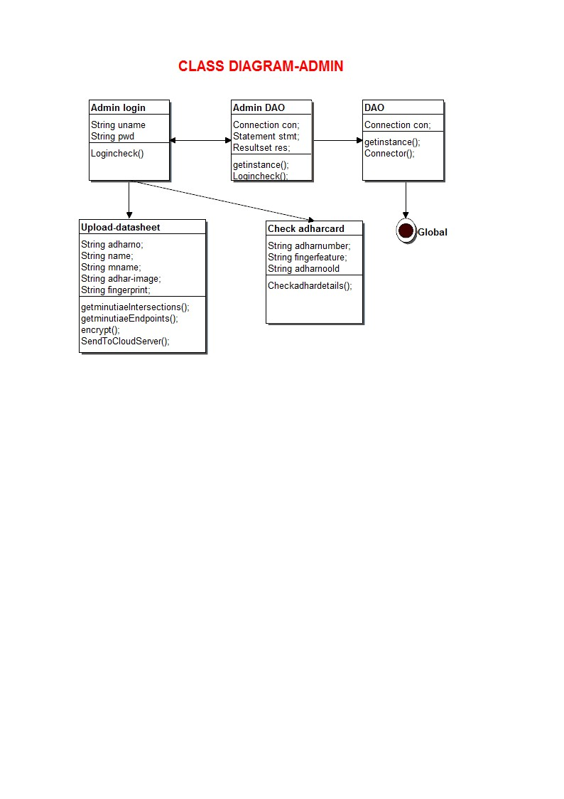
Class Diagram

Slide 29
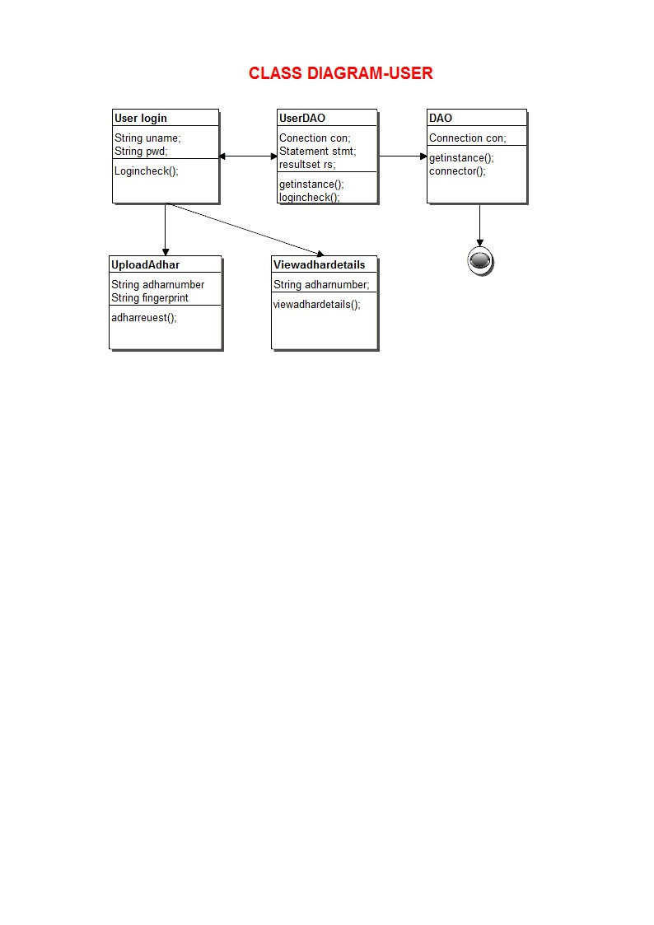

Slide 30
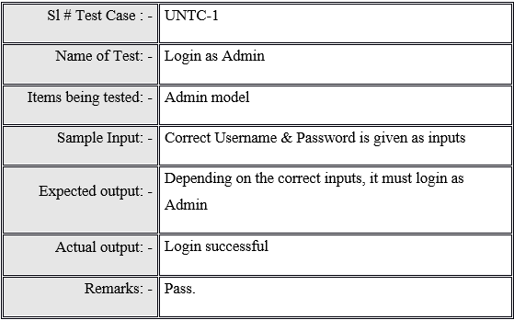
TESTING
1-UNIT TESTING:
Initialization testing is the first level of dynamic testing and is first the responsibility of developers and then that of the test engineers. Unit testing is performed after the expected test results are met or differences are explainable/acceptable.

Slide 31
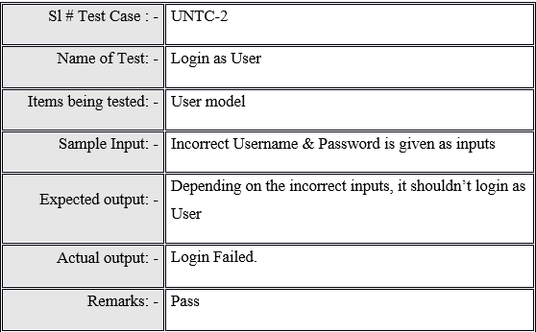

Slide 32
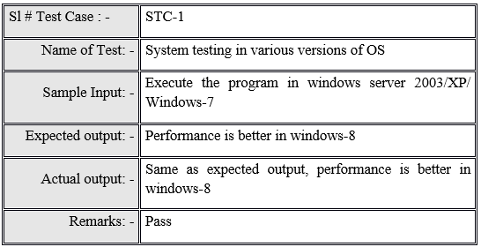
2-SYSTEM TESTING:
To test the complete system in terms of functionality and non functionality. It is black box testing, performed by the Test Team, and at the start of the system testing the complete system is configured in a controlled environment.

Slide 33
3-FUNCTIONAL TESTING: Functions are tested by feeding them input and examining the output, and internal program structure is rarely considered.
Test Case Id | Test Input | Expected Result | Actual Result | Remarks
F_01 | Enter valid admin username and password click on login button | Admin should be navigated to homepage with the following details: User creation, user details, cloud config, key setting, upload files, keyword rank, user request change password and logout | Admin is navigated to homepage with the following details: User creation, user details, cloud config, key setting, upload files, keyword rank, user request change password and logout | Pass

Slide 34
Test Case Id |  | Test Input | Expected Result | Actual Result | Remarks
F_02 | Enter valid user username and password in the user login page click on login button | User should be navigated to the homepage with the following: user profile, send request search keyword, change password file request and logout |  | User is navigated to the homepage with the following details user profile, send request search keyword, change password file request and logout | Pass
F-03 | Click on change password on admin module to change password | Admin should be navigated to change password page there the admin change password by providing the new password. |  | Admin is navigated to change password page there the admin change password by providing the new password. | Pass
F_01
Enter valid admin username and password click on login button
Admin should be navigated to homepage with the following details: User creation, user details, cloud config, key setting, upload files, keyword rank, user request change password and logout
Admin is navigated to homepage with the following details: User creation, user details, cloud config, key setting, upload files, keyword rank, user request change password and logout
Pass

Slide 35
Test Case Id |  | Test Input | Expected Result | Actual Result | Remarks
F-04 | Click on change password on user module to change password | User should be navigated to change password page there the admin change password by providing the new password. |  | User is navigated to change password page there the admin change password by providing the new password. | Pass

Slide 36
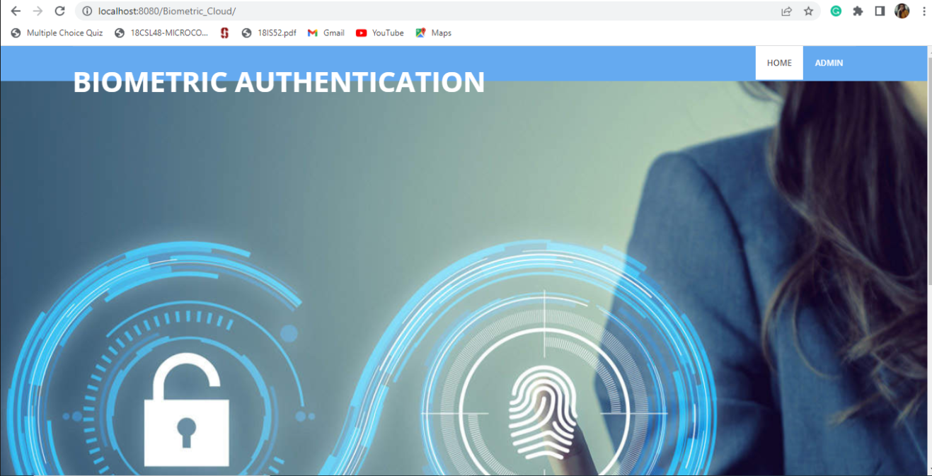
Results and Discussions

Slide 37


Slide 38


Slide 39
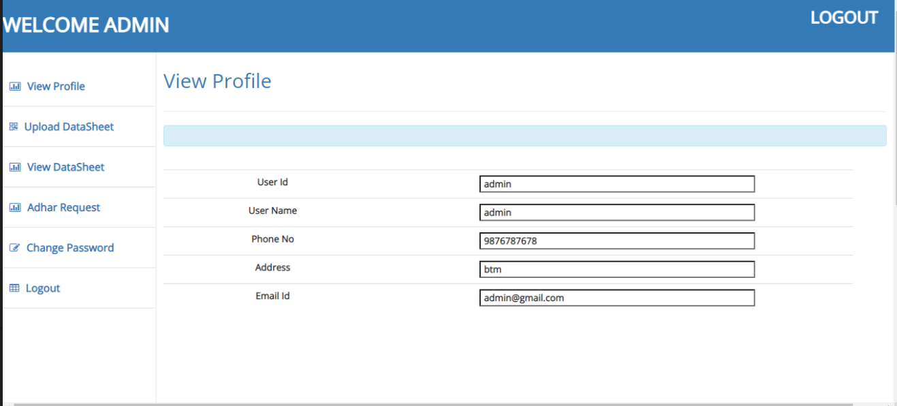

Slide 40
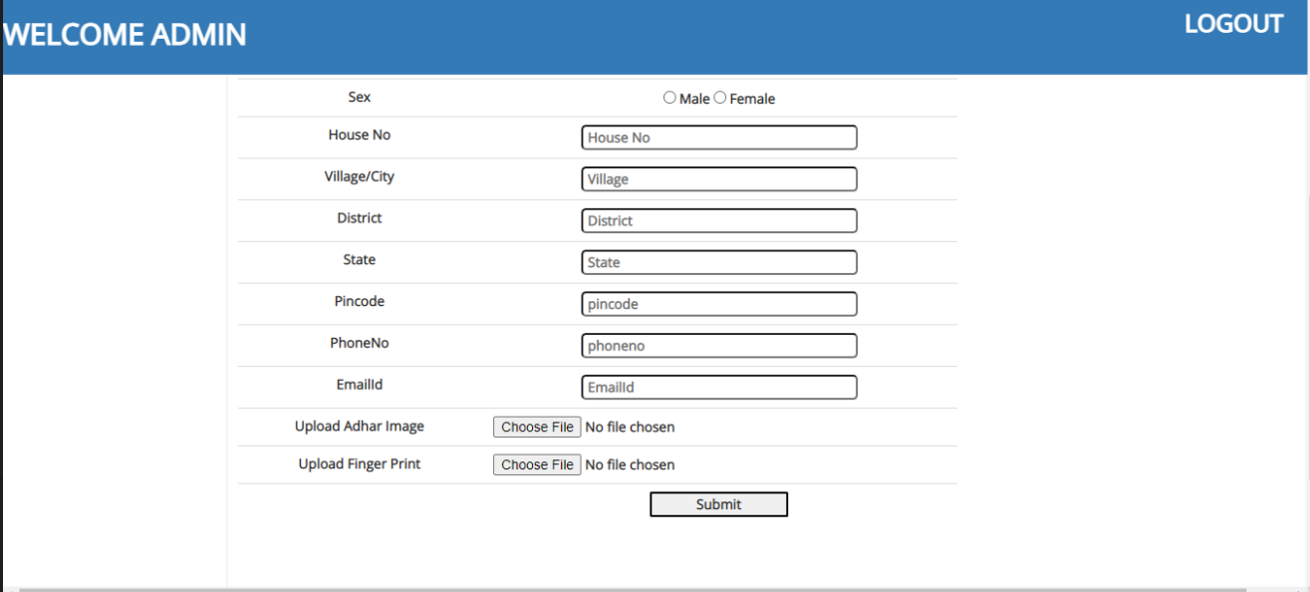

Slide 41
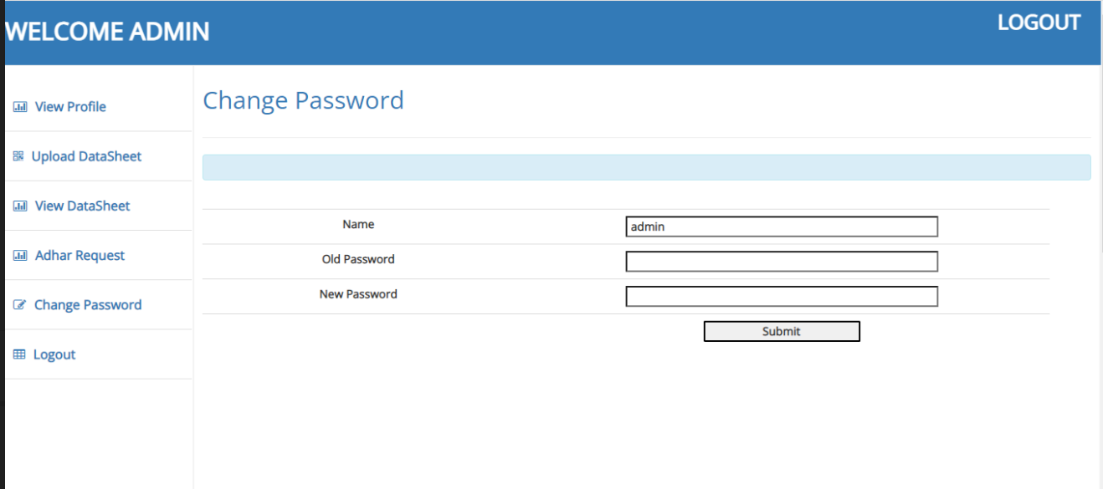
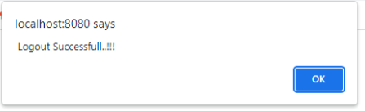

Slide 42


Slide 43
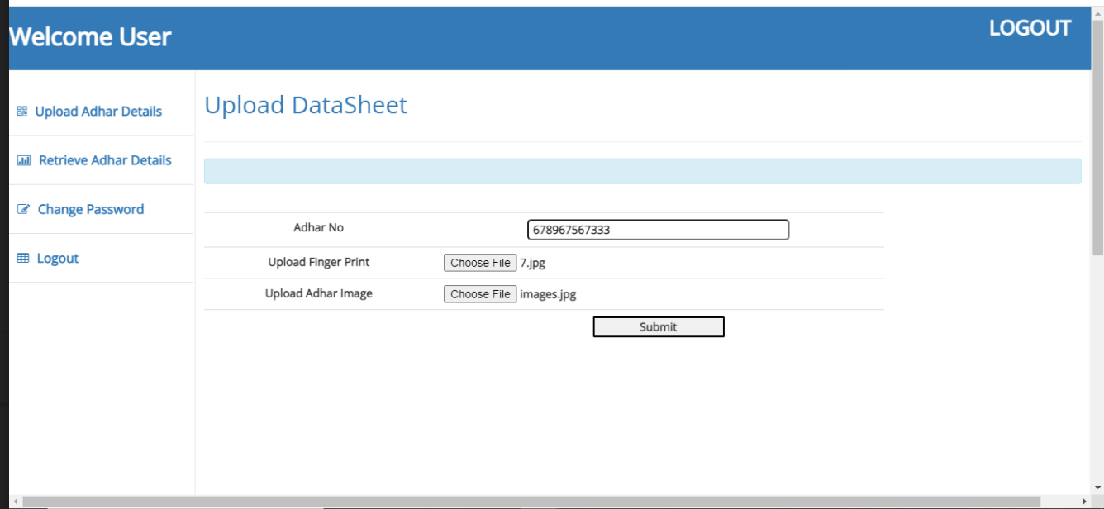

Slide 44
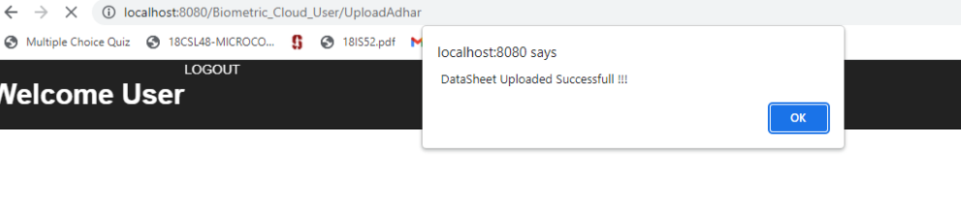

Slide 45

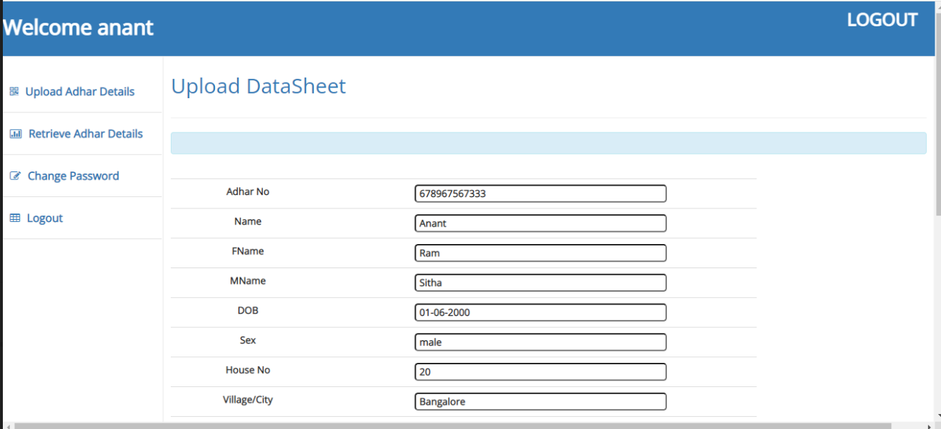

Slide 46

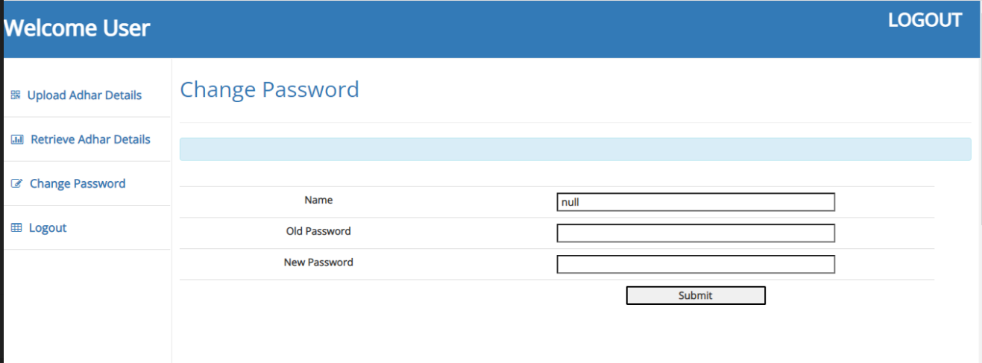

Slide 47
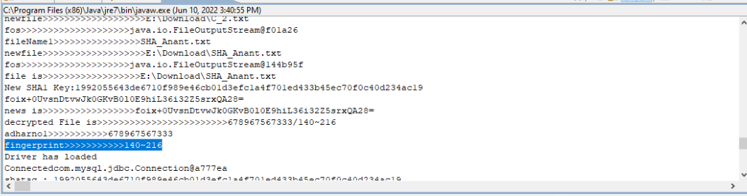

Slide 48
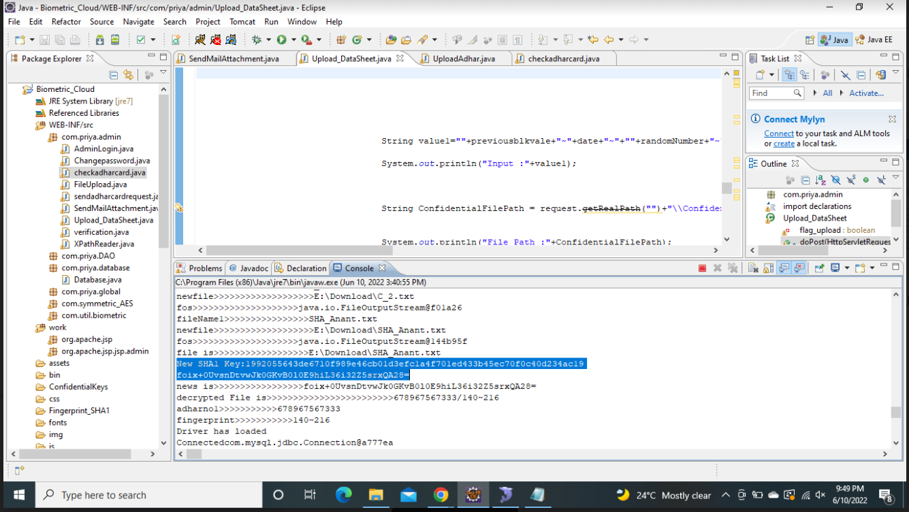

Slide 49
Paper Published Details
Survey Paper: https://drive.google.com/file/d/1OZJoCJTWZ6-sK3iLVTe_wpT-RdikvfPF/view?usp=drivesdk
Technical paper: Technical paper(blockchain) 2.pdf - Google Drive

Slide 50
CONCLUSION
We proposed a novel privacy-preserving biometric identification scheme in cloud computing.
To realize the efficiency and secure requirements, we have designed a new encryption algorithm and cloud authentication certification.
The detailed analysis shows it can resist the potential attacks. Besides, through performance evaluations, we further demonstrated the proposed scheme meets the efficiency need well.

Slide 51
REFERENCES
[1] A. Jain, L. Hong, and S. Pankanti, ‘‘Biometric identification,’’ Commun. ACM, vol. 43, no. 2, pp. 90–98, 2000.
[2]. R. Allen, P. Sankar, and S. Prabhakar, ‘‘Fingerprint identification technology,’’ in Biometric Systems. London, U.K.: Springer, 2005, pp. 22–61.
[3] J. de Mira, Jr., H. V. Neto, E. B. Neves, and F. K. Schneider, ‘‘Biometricoriented iris identification based on mathematical morphology,’’ J. Signal Process. Syst., vol. 80, no. 2, pp. 181–195, 2015.
[4] S. Romdhani, V. Blanz, and T. Vetter, ‘‘Face identification by fitting a 3D morphable model using linear shape and texture error functions,’’ in Proc. Eur. Conf. Comput. Vis., 2002, pp. 3–19.
[5] Y. Xiao et al., ‘‘A survey of key management schemes in wireless sensor networks,’’ Comput. Commun., vol. 30, nos. 11–12, pp. 2314–2341, Sep. 2007.
[6] X. Du, Y. Xiao, M. Guizani, and H.-H. Chen, ‘‘An effective key management scheme for heterogeneous sensor networks,’’ Ad Hoc Netw., vol. 5, no. 1, pp. 24–34, 2007.

Slide 52
[7] Oscar Delgado-Mohatar, Julian FierrezRuben Tolosana, and Ruben Vera-Rodriguez, Blockchain and Biometrics: “A First Look into Opportunities and Challenges”, In book: Blockchain and Applications, DOI: 10.1007/978-3-030-23813-1_21.
[8] Subhas Barman, Debasis Samanta, Samiran Chattopadhyay, “Fingerprint-based crypto-biometric system for network security”, EURASIP Journal on Information Security, DOI: 10.1186/s13635-015-0020-1.
[9] Guy Zyskind, Oz Nathan, A. Sandy. Pentland, “Decentralizing Privacy: Using Blockchain to Protect Personal Data”, 2015 IEEE Security and Privacy Workshops, DOI: 10.1109/SPW.2015.27.
[10] Li X, Jiang P, Chen T, Luo X, Wen Q,“A survey on the security of blockchain systems”, Future Generation Computer System. https://doi.org/ 10.1016/j.future.2017.08.020.
[11] Nakamoto S., “Bitcoin: A Peer-to-Peer Electronic Cash System” https://bitcoin.org/bitcoin.pdf.
[12] Jaikaran C, “Blockchain: Background and Policy Issues”, Congressional Research Service. https://www.americanvoiceforfreedom.org/wp-content /uploads/2018/03/Blockchain-Background-and-Policy-Issues.pdf.

Slide 53
[13] Zhang R, Zheng Y “A Survey on Biometric Authentication: Towards Secure and Privacy-Preserving Identification”. IEEE ACCESS, Vol.7, pp.5994-6009. DOI: 10.1109/ACCESS.2018.2889996.
[14] Odelu V, “IMBUA: Identity Management on Blockchain for Biometrics-Based User Authentication”.DOI: 10.1007/978-3-030-23813-1_1.

